Slide 1



Concurrent Programming
Prof. Jayvirsinh Kher, Assistant Professor
Computer Science & Engineering

Slide 2


CHAPTER-5
Concurrent Programming

Slide 3

What is Concurrency ?
• According to dictionary : “Two or more events happening at the same time”
• In Computer Science : “The execution of two or more tasks in overlapping time periods that are not necessarily simultaneous”
Image source : Google

Slide 4
Multi Threaded Programming

Slide 5
INTRODUCTION
• Contains two or more parts that can run concurrently.
• Each part of such program is called a thread
• Thread defines a separate path of execution
• It cannot exist on its own. It must be part of a process.
• Executing several tasks simultaneously is called “MultiTasking”.
There are two types of multitasking
(1) Process Based Multitasking
(2) Thread Based Multitasking

Slide 6
PROCESS BASED MULTITASKING
• Each task separately independent process
• Example : While typing a java program in editor we can able to listen audio songs by MP3 Player in the system. At the same time we can download a file from the internet. All these tasks are executing simultaneously and independent of each other. Hence it is process based multitasking.
• Best suitable at OS level

Slide 7
THREAD BASED MULTITASKING
• Each task separately independent part of the same program and each independent part is called a Thread.
• Best suitable for programmatic level
• Java provides in built support for multithreading
• The main important application areas of multithreading are:
1. To implement multimedia graphics.
2. To develop video games etc.
3. To develop web and application servers

Slide 8
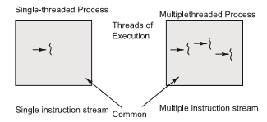
DEFINING THREAD
• A process is a program in execution.
• Threads are light-weight processes within a process
Image source : Google

Slide 9
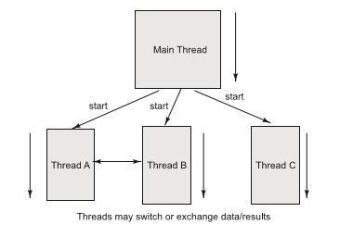
THREADS IN JAVA
Image source : Google

Slide 10
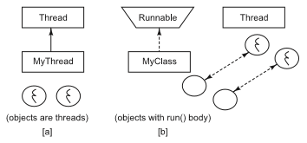
THREADS IN JAVA
• We can define a thread in following ways:
[a] By extending Thread class
[b] By implementing Runnable interface
Image source : Google

Slide 11


www.paruluniversity.ac.in

